Slide 1
NAÏVE BAYES AND BAYESIAN NETWORKS

Slide 2
基本概念

Slide 3
贝叶斯公式
It's useful for when you know P(B|A) but you want to calculate P(A|B), e.g.
We know P(shorts|sunny) but we want to know P(sunny|shorts)
We know P(red ball | box A) but we want to know P(box A | red ball)
We know P("bottled" | Water) but we want to know P(Water | "bottled")

Slide 4
先验/后验
In the sunny/cloudy shorts/jeans example,
What's the prior distribution?
The usual probability of a sunny or cloudy day in Stanford
What's the evidence?
What I'm wearing
What's the posterior distribution?
The probability that it's sunny or cloudy, given what I'm wearing

Slide 5
Bayes Rule: prior and posterior
Prior
Posterior
Evidence

Slide 6
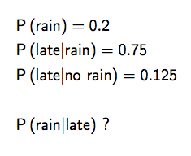
贝叶斯公式

Slide 7
贝叶斯公式

Slide 8
例：盒子分类
1
10
I choose a box at random (50/50 chance)
Then I randomly select a ball from the chosen box
I show you the resulting ball (red)
Your job: based on this evidence, calculate the probability that the ball came from Box A vs. Box B. P(Box A | red) = ? P(Box B | red) = ?
red
Box A
10% red
90% green
1
2
9
10
green
7
10
red
1
2
Box B
70% red
30% green
3
10
green

Slide 9
先验/后验
The game is about figuring out which box was used, given evidence (the ball).
The prior distribution is the initial probability distribution of choosing each box.
e.g. P(box A)=50% and P(box B)=50%
"Our beliefs before evidence".
The posterior distribution is the probability distribution of which box you think I used, given the new evidence (the ball).
e.g. P(box A|red ball) = 1/8 = 12.5%, P(box B|red ball) = 7/8 = 87.5%
"Our beliefs after evidence"

Slide 10
你能分类是哪个盒子吗？
We want to build a classifier for the mystery box game.
Given a ball of some color (the evidence), we want to determine which box it is most likely to have come from.
To do this, we need to calculate the posterior, i.e. P(Box A | ball color) = P(ball color | box A) P(Box A) P(ball color) P(Box B | ball color) = P(ball color | box B) P(Box B) P(ball color)
Finally, choose the box that has the highest value in the posterior. This is the classification result.

Slide 11
课堂练习

Slide 12
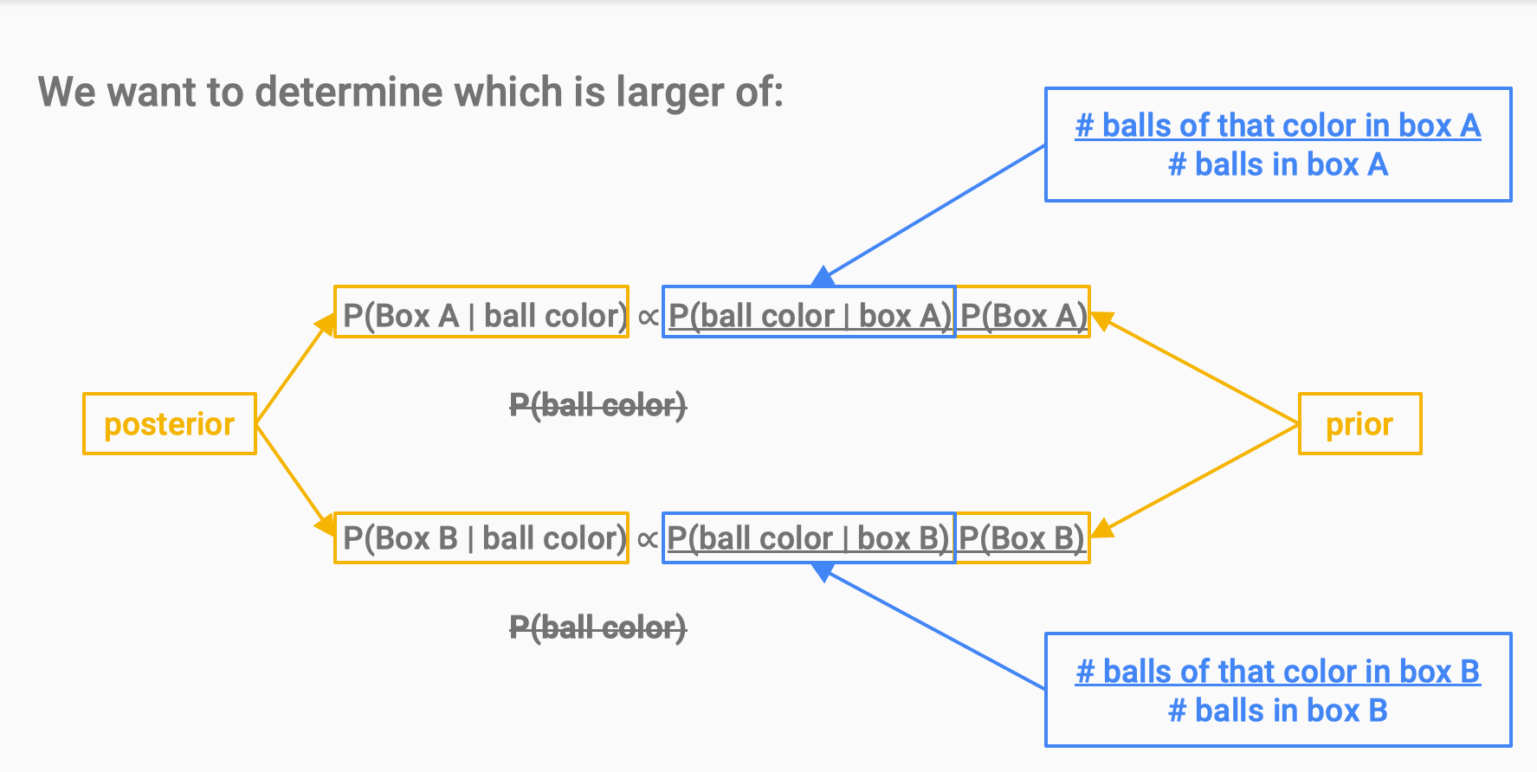

Slide 13
算法
Preparatory Step: For each color c and each box b, calculate: P(color c | box b) = # color c balls in box b # balls in box b
Classifier: To classify a ball of color c, calculate P(box b | color c) ∝ P(box b) ⨉ P(color c | box b) and choose the box with the highest value.

Slide 15
Mystery box game classifier algorithm
Preparatory Step: For each color c and each box b, calculate: P(color c | box b) = # color c balls in box b # balls in box b
Classifier: To classify a sequence of n balls of color c₁ ... c_{n} calculate
P(box b | colors c₁ ... c_{n}) ∝ P(box b) ⨉ P(color c₁ | box b) ⨉ ... ⨉ P(color c_{n} | box b) and choose the box with the highest value.
This is called a Naive Bayes classifier

Slide 16
应用：文本分类
Given evidence (balls), figure out which box they came from
Given evidence (tweet = sequence of words), figure out which category they came from.
Box A
10% red
90% green
Box B
70% red
30% green
Food
Water
Energy
Medical
None
we need a generator

Slide 17
Current uses of Naive Bayes classifier
news categorization
spam detection
diagnosis models for medicine

Slide 18
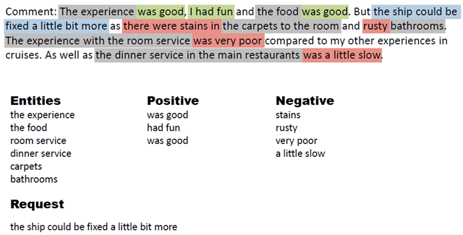
Recent-past uses of Naive Bayes classifier
face recognition (and other image tasks)
sentiment analysis
Both tasks now tackled with neural networks

Slide 24
文本分类模型

Slide 37
流失案例

Slide 38
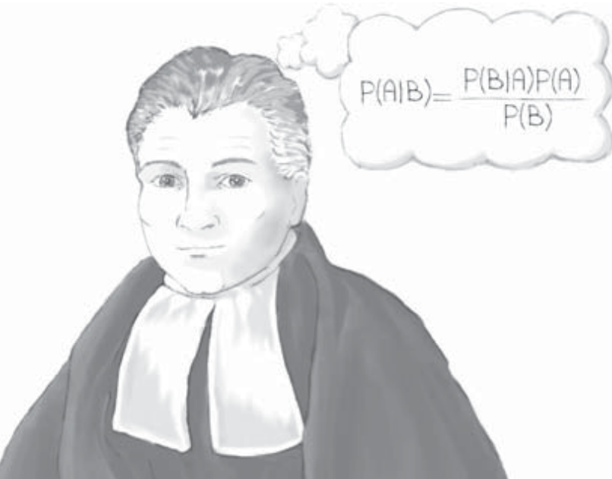

Slide 39
BAYESIAN APPROACH
In the frequentist approach to probability, the parameters are fixed, and the randomness lies in the data, which are viewed as a random sample from a given distribution with unknown but fixed parameters.
In Bayesian statistics, the parameters are considered to be random variables, and the data are considered to be known. The parameters are regarded as coming from a distribution of possible values, and Bayesians look to the observed data to provide information on likely parameter values.
Notes:
In the frequentist approach to probability, the population parameters are fixed constants whose values are unknown. These probabilities are defined to be the relative frequencies of the various categories, where the experiment is repeated an indefinitely large number of times. It is this “long-run” behavior that defines probability for the frequentist approach.
In the frequentist approach to probability, the parameters are fixed, and the randomness lies in the data, which are viewed as a random sample from a given distribution with unknown but fixed parameters.
In Bayesian statistics, the parameters are considered to be random variables, and the data are considered to be known. The parameters are regarded as coming from a distribution of possible values, and Bayesians look to the observed data to provide information on likely parameter values.
https://statisticsbyjim.com/basics/populations-parameters-samples-inferential-statistics/
A parameter is a value that describes a characteristic of an entire population, such as the population mean. Because you can almost never measure an entire population, you usually don’t know the real value of a parameter. In fact, parameter values are nearly always unknowable. While we don’t know the value, it definitely exists.
For example, the average height of adult women in the United States is a parameter that has an exact value—we just don’t know what it is!
The population mean and standard deviation are two common parameters. In statistics, Greek symbols usually represent population parameters, such as μ (mu) for the mean and σ (sigma) for the standard deviation.
A statistic is a characteristic of a sample.

Slide 40
贝叶斯方法
Let 𝜃 represent the parameters of the unknown distribution. Bayesian analysis requires elicitation of a prior distribution for 𝜃, called the prior distribution, p(𝜃).
Once the data have been observed, prior information about the distribution of 𝜃 can be updated, by factoring in the information about 𝜃 contained in the observed data X. This modification leads to the posterior distribution, p(𝜃|X).
This updating of our knowledge about 𝜃 from prior distribution to posterior distribution was first performed by the Reverend Thomas Bayes in 1763.
Notes:
This prior distribution can model extant expert knowledge, if any, regarding the distribution of 𝜃. For example, churn1 modeling experts may be aware that a customer exceeding a certain threshold number of calls to customer service may indicate a likelihood to churn. This knowledge can be distilled into prior assumptions about the distribution of customer service calls, including its mean and standard deviation.
If no expert knowledge regarding the prior distribution is available, Bayesian analysts may posit a so-called non-informative prior, which assigns equal probability to all values of the parameter. For example, the prior probability of both churners and non-churners could be set at 0.5, using a non-informative prior.

Slide 41
Likelihood function
Posterior distribution
Prior distribution
Normalizing factor
Marginal distribution
Notes:
As the posterior is a distribution rather than a single value, we can conceivably examine any possible statistic of this distribution that we are interested in, such as the first quartile, or the mean absolute deviation (Figure 14.1).

Slide 42
MAXIMUM A POSTERIORI (MAP) CLASSIFICATION
For an estimate, it is common to choose the posterior mode, the value of 𝜃 which maximizes p(𝜃|X), the MAP method
The Bayesian MAP classification is optimal (Mitchell³ page 174).
³ Mitchell, Machine Learning, WGB-McGraw-Hill, Boston

Slide 43
似然
当前测得的数据，模型算得的它发生的概率
例：抛硬币
用二项分布模型它
正面Head概率是$θ$
抛出了HTTHH
似然是多少？

Slide 44
最大似然估计
我们需要根据数据，估计最佳的模型参数
最大似然（ML）估计：选择让似然最大的参数
例：抛硬币，用二项分布模型它，正面Head概率是$θ$
练习：
抛出了HT，似然是？
$θ$多大时，它最大？
如果抛出了HHT，最大似然估计的$θ$会比0.5大，还是小？

Slide 45
问题
根据一个人的 International Plan，Voice Mail Plan
预测
是否流失

Slide 46
Example
We shall restrict our example to only two categorical predictor variables, International Plan and Voice Mail Plan, and the categorical target variable, churn.

Slide 47
 |  | Churn
 |  | False | True
I∩V | No | 2794 | 447
 | Yes | 56 | 36
p(I∩V | C) = 36/(36+447)=0.0745
p(I∩V | $\overline{C}$) = 56/(56+2794)=0.0196
 |  | Churn
 |  | False | True
I∩$\overline{V}$ | No | 2720 | 382
 | Yes | 130 | 101
p(I∩$\overline{V}$ | C)=101/(101+382)=0.2091
p(I∩$\overline{V}$ | $\overline{C}$)=130/(130+2720)=0.0456
 |  | Churn
 |  | False | True
$\overline{I}$∩V | No | 2064 | 439
 | Yes | 786 | 44
p($\overline{I}$∩V | C) = 0.0911
p($\overline{I}$∩V | $\overline{C}$) = 0.2758
 |  | Churn
 |  | False | True
$\overline{I}$∩$\overline{V}$ | No | 972 | 181
 | Yes | 1878 | 302
p($\overline{I}$∩$\overline{V}$ | C) = 0.6253
p($\overline{I}$∩$\overline{V}$ | $\overline{C}$) = 0.6589

Slide 48
新样本预测
Suppose we have a new record, where the customer belongs to the International Plan and Voice Mail Plan.

Slide 49
POSTERIOR ODDS RATIO
The posterior odds ratio represents a measure of the strength of evidence in favor of a particular classification, and is calculated as follows:
Example,
The posterior odds ratio allows us to assess the strength of evidence for MAP classifications, which is more helpful to the analyst than a simple up-or-down decision.
Notes:
后验概率比

Slide 50
BALANCING THE DATA
Balanced sampling methods are used to reduce the disparity among the proportions of target classes appearing in the training data
In Chapter 4, we learned two methods for balancing the data.
1. Resample a number of rare records.
2. Set aside a number of non-rare records.
Notes:
后验概率比

Slide 51
Example
In our case, we have 14.49% of the records representing churners, which we may consider somewhat uncommon. Let us balance the training data set by using “set-aside”, so that the ratio is improved to approximately 25%.
(i) accept all of the 483 churn = true records
(ii) take a random sample of 50% (1425) of our churn = false records
With this balanced data, we have
Reversed the prior classification decision
Notes:
Thus, after balancing, CMAP, the MAP estimate of churn is churn = true, because 0.0189 is the greater value. Balancing has reversed the classification decision for this category of customers.

Slide 52
Curse of dimensionality
The number of probabilities need to be calculated to find the MAP classification would be on the order of k^{m}, where k is the number of classes for the target variable, and m is the number of predictor variables.
Suppose we are trying to predict the marital status (k=5: single, married, divorced, widowed, separated) of individuals based on a set of m =10 demographic predictors. Then, k^{m} = 5¹⁰ = 9, 765, 625 probabilities.
Curse of dimensionality
Here is where the search space explodes, so, if there is a way to cut down on the search space for this problem, then it is to be found right here
Notes:
假设我们试图根据一组m=10的人口统计学预测因子来预测个人的婚姻状况（k=5：单身、已婚、离婚、丧偶、分居）

Slide 53
NAÏVE BAYES CLASSIFICATION
k^{m}
km
For example, for the churn dataset,
Churn = false
Correlated predictors should be handled by using PCA …
Notes:
Correlated predictors should be handled by using PCA …

Slide 54
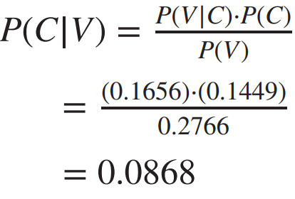
Notes:
Table 14.2，
第一行，在给定了 Inter Plan=yes条件下，看churn=True的概率，counts 分别是有Inter plan的Churn=False和Churn=True的用户数
第二行，在给定了 Voice Mail Plan=yes条件下，看churn=True的概率，counts 分别是有VioceMailPlan的Churn=False和Churn=True的用户数

Slide 55
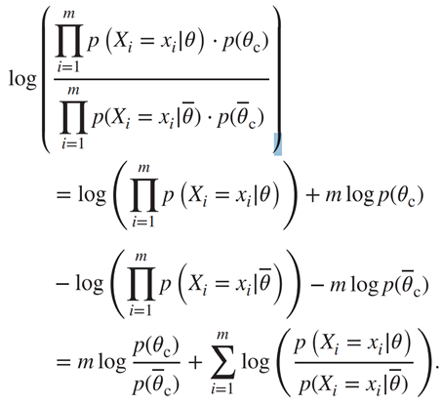
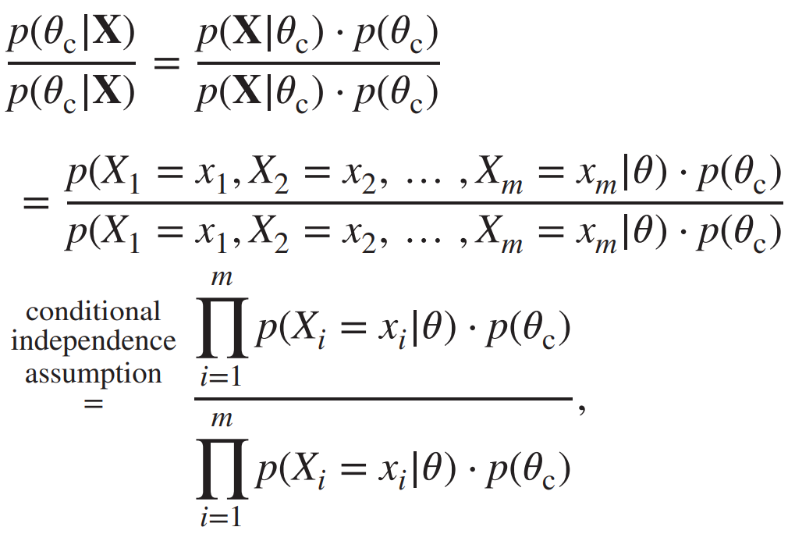
INTERPRETING THE LOG POSTERIOR ODDS RATIO
The log of the posterior odds ratio can provide us with an intuitive measure of the amount that each variable contributes toward the classification decision
Each term relates to the additive contribution, either positive or negative, of each attribute.
Notes:
每个预测变量对分类决策的贡献，有正有负，有大有小，很直观，即反映了每个预测变量的重要程度

Slide 56
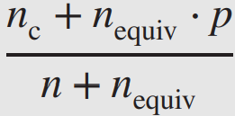
ZERO CELL PROBLEM
As the naïve Bayes classification contains a single zero probability in this product will render the entire product to be zero, thereby effectively eliminating this class from consideration.
Adjust probability estimate for zero-frequency cells: where n is the total number of records for the target class, n_{c} is the number of the n records that also have the attribute value of interest, p is the prior estimate of the probability being estimated, and n_{equiv} is a chosen constant representing the equivalent sample size.
E.g., we have n=483, n_{c} = 0, p = ½, n_{equiv} = 1, the adjusted p(V|C) is:
Notes:
where n is the total number of records for the target class, n_{c} is the number of the n records that also have the attribute value of interest, p is the prior estimate of the probability being estimated, and n_{equiv} is a chosen constant representing the equivalent sample size.

Slide 57
NUMERIC PREDICTORS FOR NAÏVE BAYES CLASSIFICATION
Suppose that, in addition to International Plan and Voice Mail Plan, we also had access to Total Minutes used by the customers, along with evidence:
正态分布 For churners T_{churn} ~ N(635, 111); For non-churners T_{nonchurn}~ N(585, 84)
Suppose new customers who have 800 Total Minutes, and belong to both plans, using naïve Bayes classification. We have:
Notes:
T 服从正态分布

Slide 58
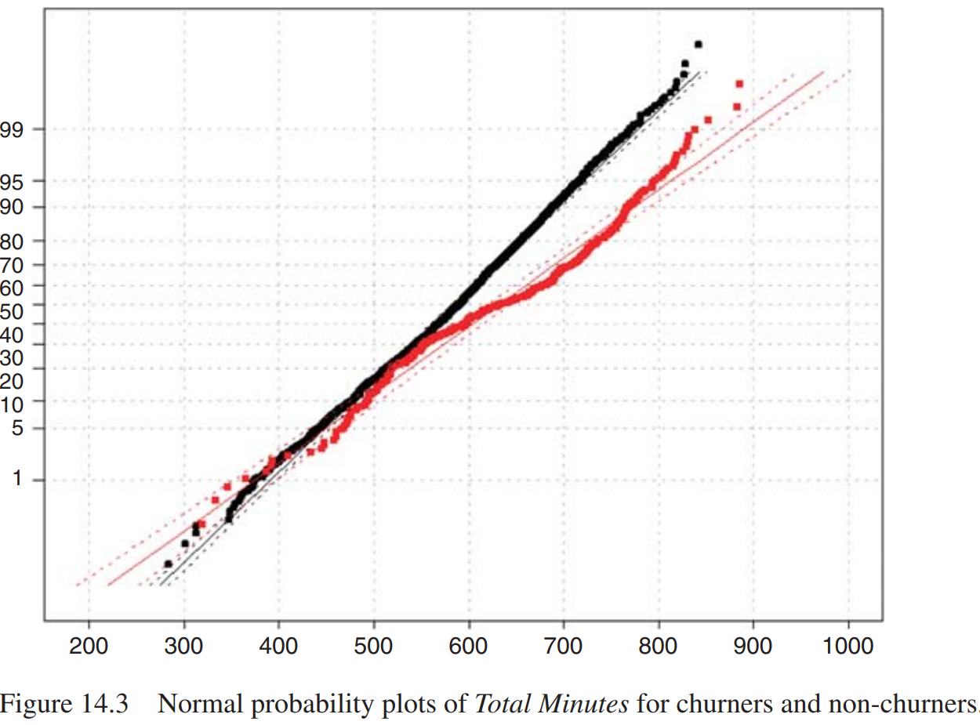
However, the real Total Minutes are as follows
Indicating that the normality assumption for churners’ Total Minutes is not validated.
不是正态分布

Slide 59
However, the real Total Minutes are as follows
直接基于数据统计
Let p(T = 800) ≈ p(798≤T≤ 802).
Data shows that 3 of the 483 churner customers, and 1 of 2850 non-churners had between 798 and 802 total minutes. So, it would be p(T = 800|C) ≈ 3/483 = 0.006211 for the churners, and p(T = 800|$\overline{C}$) ≈ 1/2850 = 0.0003509 for the non-churners.
Note: The empirical probability estimation method shown here should be verified over a range of margins of error.
Notes:
Often, non-normal distribution can be transformed to normality, using, for example, the Box–Cox transformation T(y) = (y^{𝜆}−1)/𝜆 .
However, the pattern looks like a mixture of two normal distributions, which will prove resistant to monotonic transformations to normality.
Alternatively, one may dispense with the normality assumption altogether, and choose to work directly with the observed empirical distribution of Total Minutes for churners and non-churners
--------------
The empirical probability estimation method shown here should be verified over a range of margins of error.
Above, we found the numbers of records within a margin of error of 2 records(798 ≤ T ≤ 802). The reader may verify that that there are 8 churn records and 3 non-churn records within 5 minutes of the desired 800 minutes; and that there are 15 churn records and 5 non-churn records within 10 minutes of the desired 800 minutes. So the approximate 3 : 1 ratio of churn records to non-churn records in this area of the distribution seems fairly stable.
读者可以验证在所需800分钟的5分钟内有8个流失记录和3个未流失记录，并且在10分钟内有15个流失记录和5个未流失记录需要800分钟。因此，流失记录与未流失记录的比例约为3:1这一地区的记录分布似乎相当稳定

Slide 60
条件独立

Slide 64
贝叶斯网络
更复杂的关系怎么办？

Slide 79
应用

Slide 80
BAYESIAN BELIEF NETWORKS
Naïve Bayes classification assumes that the attributes are conditionally independent, given the value of the target variable. This assumption may in fact be too strong for environments where dependence exists among the predictor variables.
Bayesian belief networks (BBNs), also called Bayesian networks or Bayes nets, taking the form of a DAG, are designed to allow joint conditional independencies to be defined among subsets of variables.

Slide 81
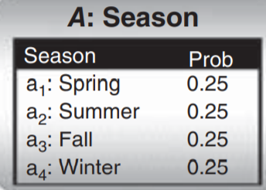
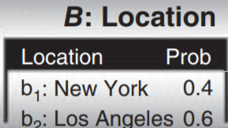
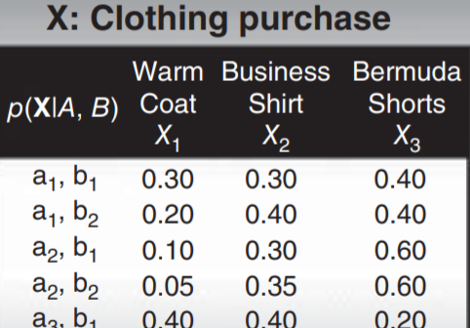
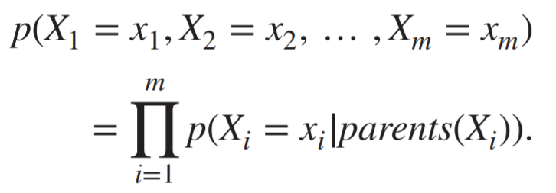
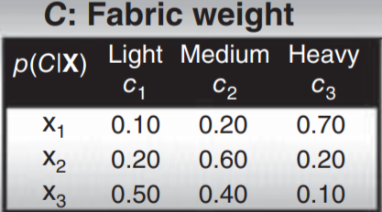
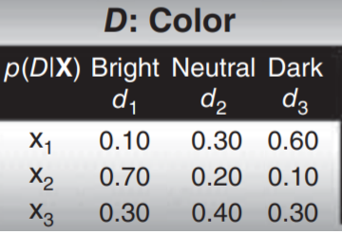
Each variable in a Bayesian network is conditionally independent of its non-descendants in the network, given its parents. Thus, we have
Note that the child node probability depends only on its parents.
Notes:
DAG, 有向无环图

Slide 82
Why have we such a DAG?
What is the dependence relationship among the five variables?
Specify all of the entries in the probability tables for each node

Slide 83
USING BBNs TO FIND PROBABILITIES
(winter, New York, light, neutral, shorts)

Slide 84
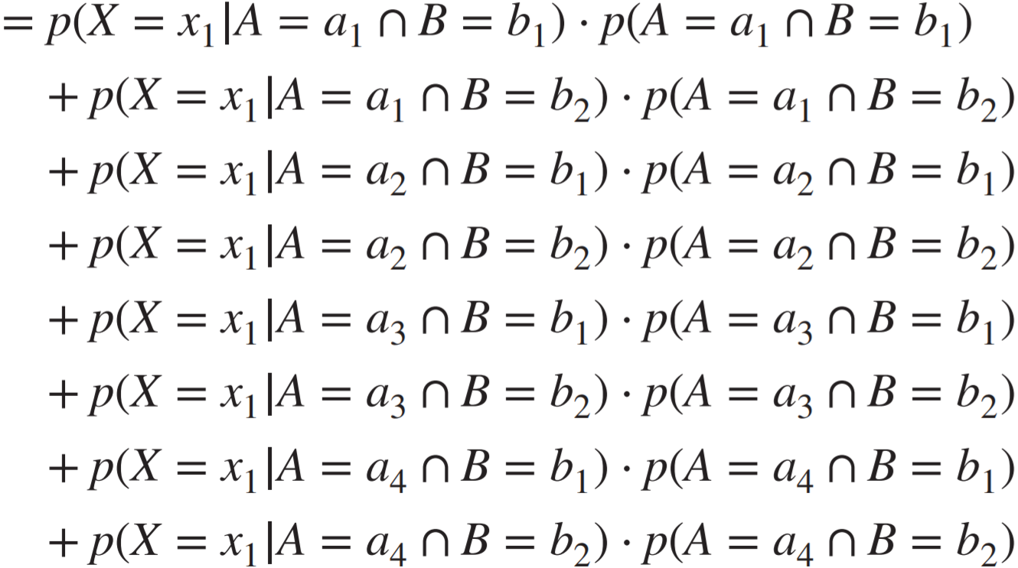
USING BBNs TO FIND PROBABILITIES

Slide 85
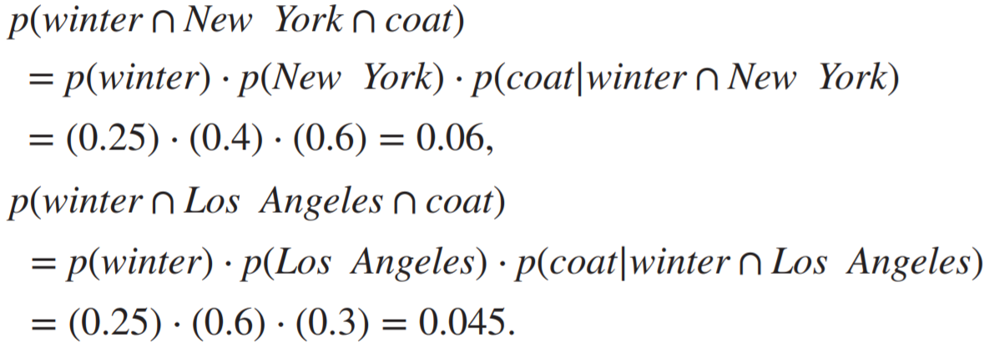
USING BBNs TO FIND PROBABILITIES

Slide 86
Disscuss
when some of the field values in a probability table are hidden or unknown, then we need to turn to other methods, with the goal of filling in all the entries in the local probability distribution table
Discern the unknown structure of Bayes nets by studying the dependence and independence relationships among the observed variable values.

Slide 87
Summary
Given random variables X₁, X₂, … , X_{m}, with each X_{i} defined on space S_{Xi} . Then their joint space is defined as the Cartesian product S_{X1}×S_{X2}×···×S_{Xm}. The distribution of these observations of ⟨x₁, x₂, … , x_{m}⟩ over the joint space is called the joint probability distribution.
BNN represents the joint probability distribution by providing (i) a specified set of assumptions regarding the conditional independence of the variables, and (ii) the probability tables for each variable, given its direct predecessors.

Slide 88
https://github.com/apache/spark/blob/master/examples/src/main/python/ml/naive_bayes_example.py

